Slide 2
None of the versions of Ethernet uses straight binary encoding with 0 volts for a 0 bit and 5volts for a 1 bit because it leads to ambiguities.
If one station sends the bit string 0001000, others might falsely interpret it as 10000000 or 01000000 because they cannot tell the difference between an idle sender (0 volts) and a 0 bit (0 volts).
This problem can be solved by using +1 volts for a 1 and -1 volts for a 0, but there is still the problem of a receiver sampling the signal at a slightly different frequency than the sender used to generate it.
Different clock speeds can cause the receiver and sender to get out of synchronization about where the bit boundaries are, especially after a long run of consecutive 0s or a long run of consecutive 1s.
What is needed is a way for receivers to unambiguously determine the start, end, or middle of each bit without reference to an external clock.

Slide 3
Bipolar encoding
Best solution to synchronization
Signal changes in the middle of bit interval
Returns to opposite pole

Slide 5


Manchester encoding
With Manchester encoding, each bitperiod is divided into two equal intervals.
A binary 1 bit is sent by having the voltage set high during the first interval and low in the second one.
A binary 0 is just the reverse: first low and then high.
This scheme ensures that every bit period has a transition in the middle, making it easy for the receiver to synchronize with the sender

Slide 7



Differential Manchester encoding
It is a variation of basic Manchester encoding.
In it, a 1 bit is indicated by the absence of a transition at the start of the interval
A 0 bit is indicated by the presence of a transition at the start of the interval.
In both cases, there is a transition in the middle as well.

Slide 9
Examples
I/p String - 1001011

Slide 10
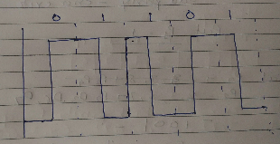

Slide 11
I/P string :-110011

Slide 12
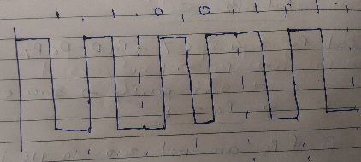

Slide 13
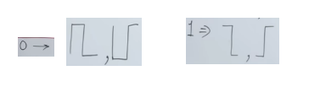

Slide 14
I/P-1001100

Slide 15
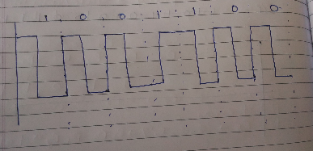

Slide 16
I/P - 1110010

Slide 17
